Slide 1


A dinosaur with a blade
Revolutionizing CI with Deno & Dagger
❤️

Slide 2

Problem with modern CI
YAML is limited
Doesn’t work locally
Hard to reuse / combine
Templating is error prone
Slow (npm installs the 🌎)
Debugging is impossible

Slide 3
Dagger
Good-bye "push & pray"
Write your pipelines in Go, Typescript or Python. Run locally or in CI. Iterate in seconds, not minutes.

Slide 4
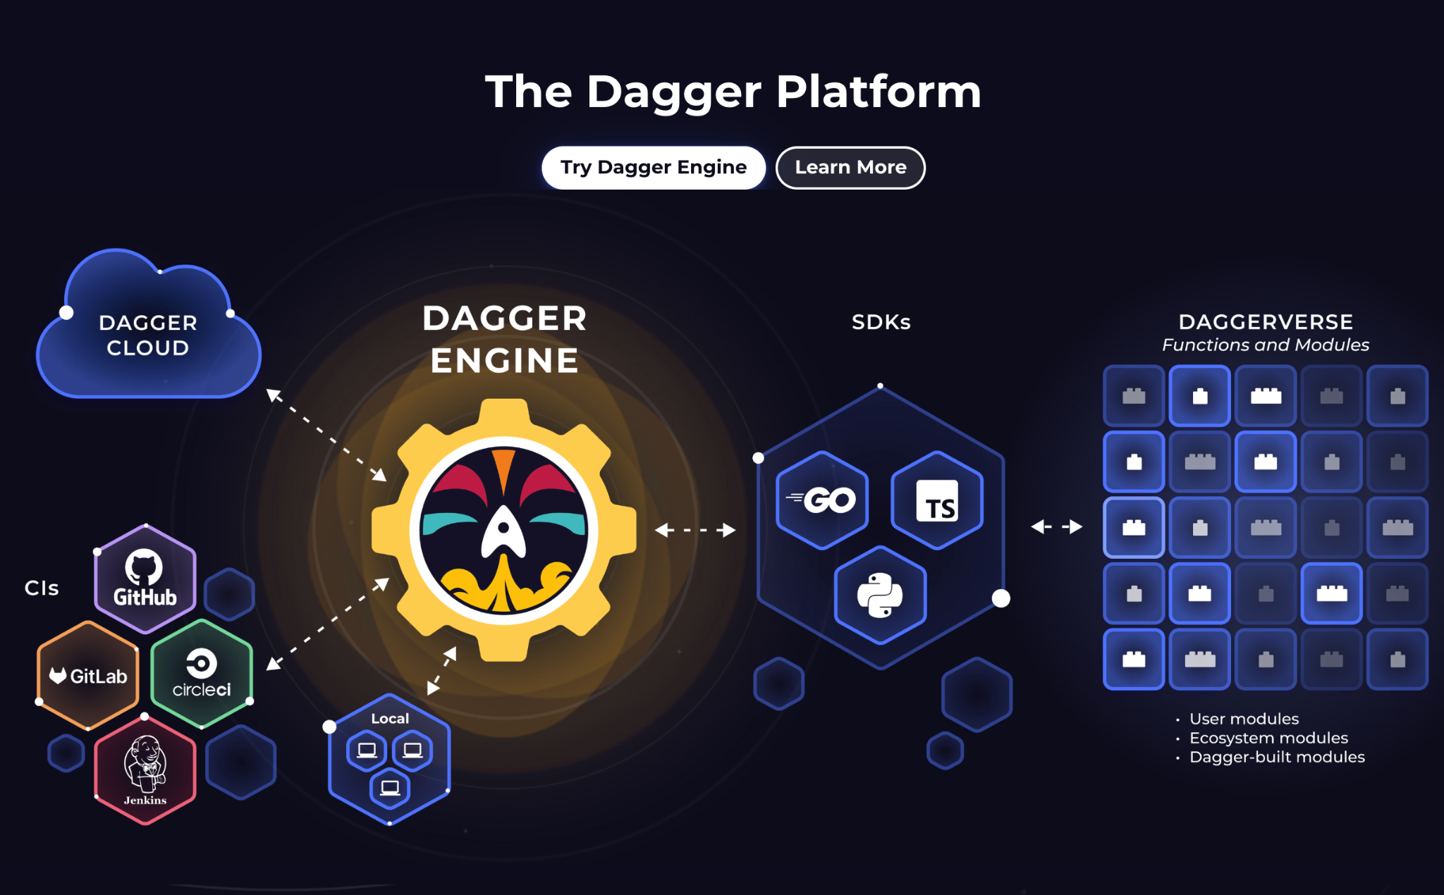

Slide 5

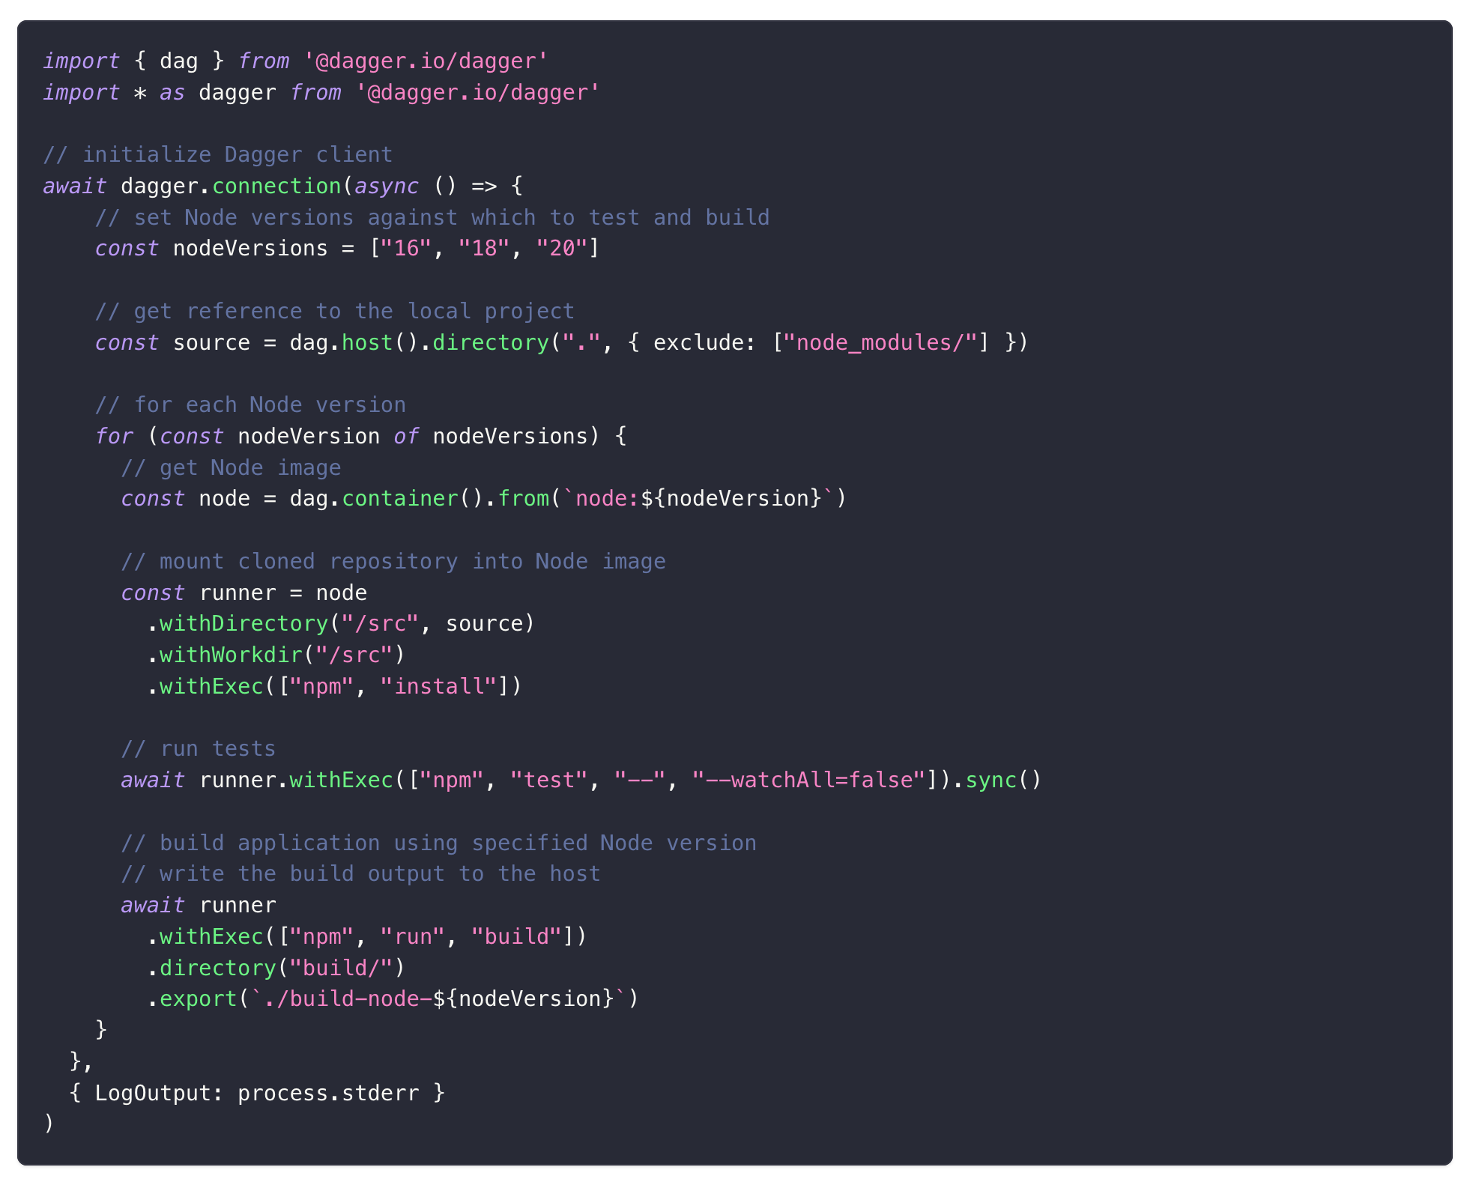
Example

Slide 6
How Dagger works ?
Dagger is a server that exposes a GraphQL API to utilize BuildKit.
An SDK is available in multiple languages to interact with the GraphQL API
Anywhere there’s a docker Deamon Dagger works

Slide 7
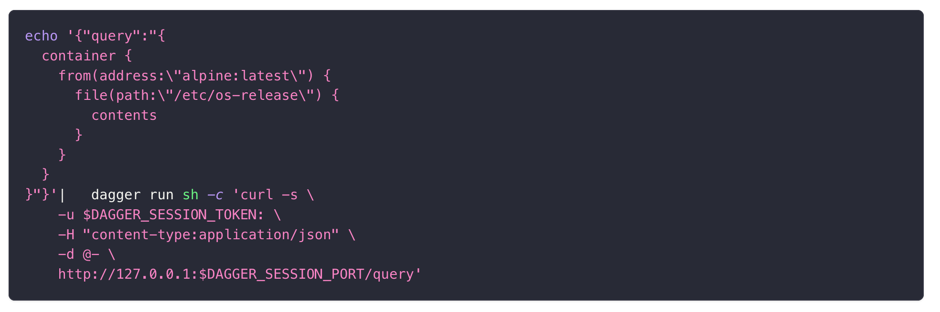
Dagger Run

Slide 8
Caching in Dagger
Layer caching -> Content Addressable ID
Volume caching -> Cache a directory

Slide 9
Dagger Benefits
Fast
Open Source
Community
As Code (Typed & Testable)
Secret
Caching
UI
Composable

Slide 10
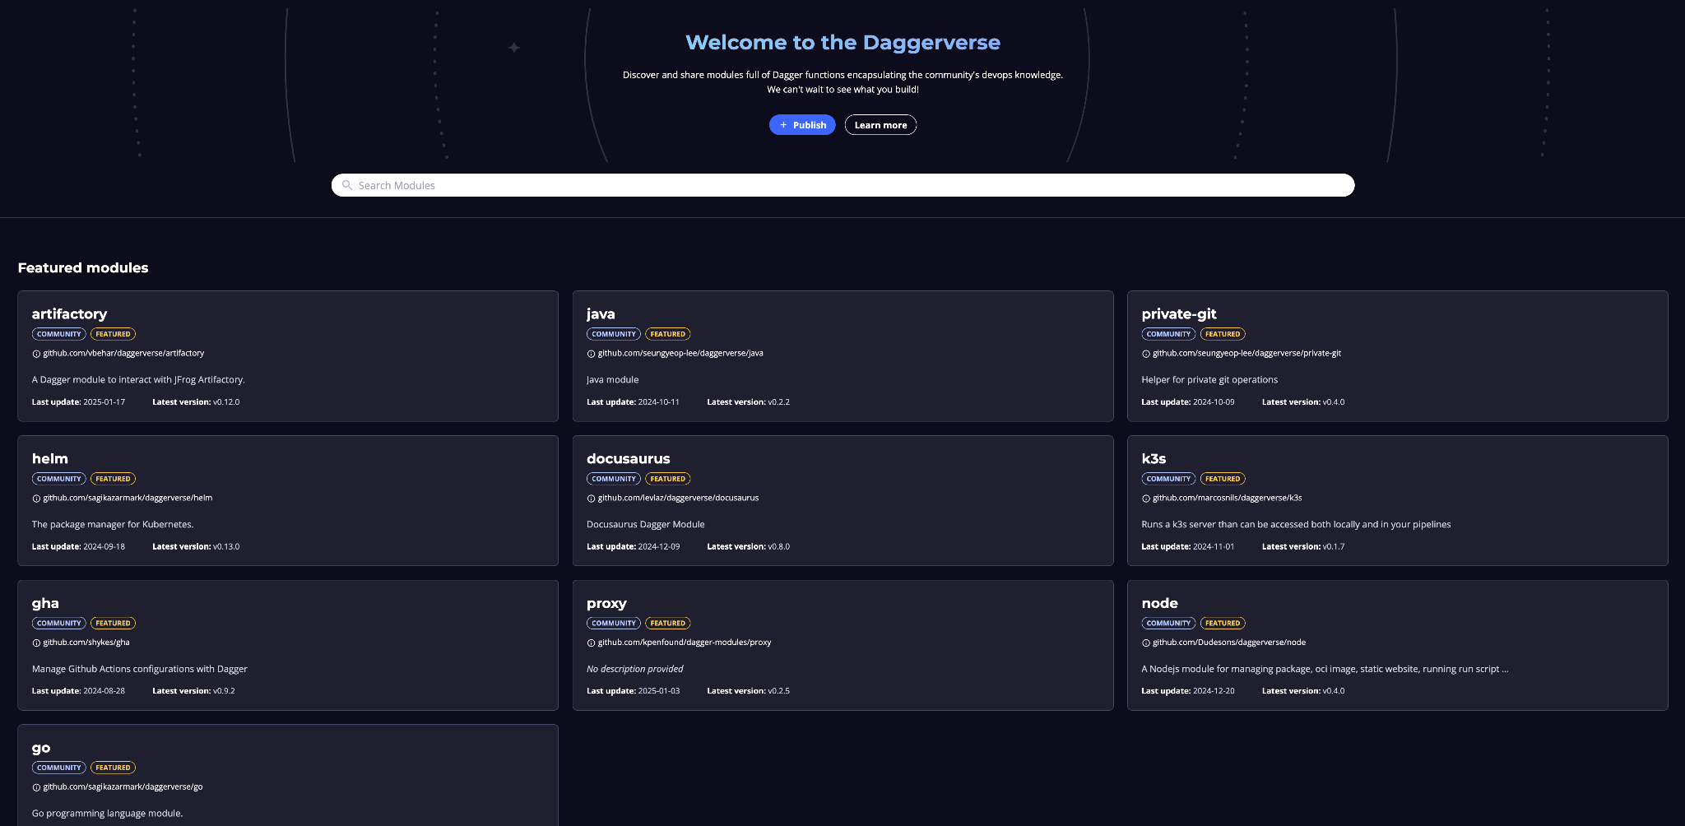
Daggerverse
https://daggerverse.dev

Slide 11
Deno
Uncomplicate JavaScript
Deno is the open-source JavaScript runtime for the modern web.

Slide 12
Deno Ecosystem
Deno deploy
fmt
Typescript first
Queues
Url import
Cron
lint
Secure
K/V

Slide 13
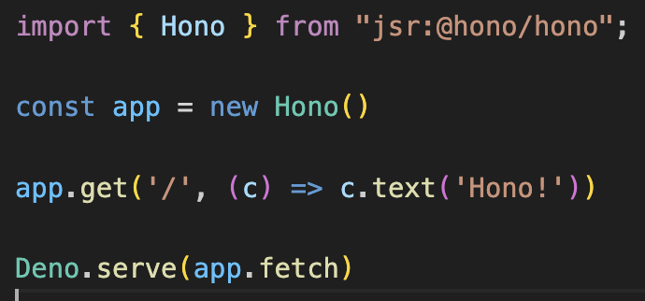
Example
Url import

Slide 14

Confession
Dagger + Deno only works with version 0.9.6 of Dagger
https://github.com/dagger/dagger/issues/4368 https://github.com/dagger/dagger/pull/9234

Slide 15
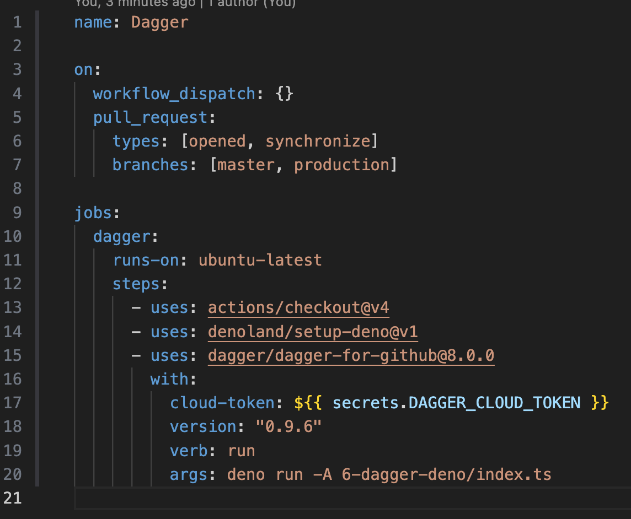
Dagger in Github Actions
https://docs.dagger.io/integrations/github-actions

Slide 16
Comparing GH Actions & Dagger
YAML is limited
Doesn’t work locally
Hard to reuse / combine
Templating is error prone
Slow (npm installs the 🌎)
Debugging is impossible
Code is modular
Good-bye "push & pray"
Import Code from anywhere (Http)
Test your code
Deno & Dagger as caches
Just add logs & breakpoints

Slide 17
Real World Use Cases
https://github.com/openmeterio/openmeter/tree/main/.dagger
https://github.com/airbytehq/airbyte/tree/master/airbyte-ci/connectors/pipelines/pipelines
https://github.com/iximiuz/cdebug/blob/main/ci/main.go
https://dagger.io/case-studies

Slide 18

Sidenote
https://infisical.com/

Slide 19

Question ?

